Slide 1
Apache Spark
Rober Makram

Slide 2
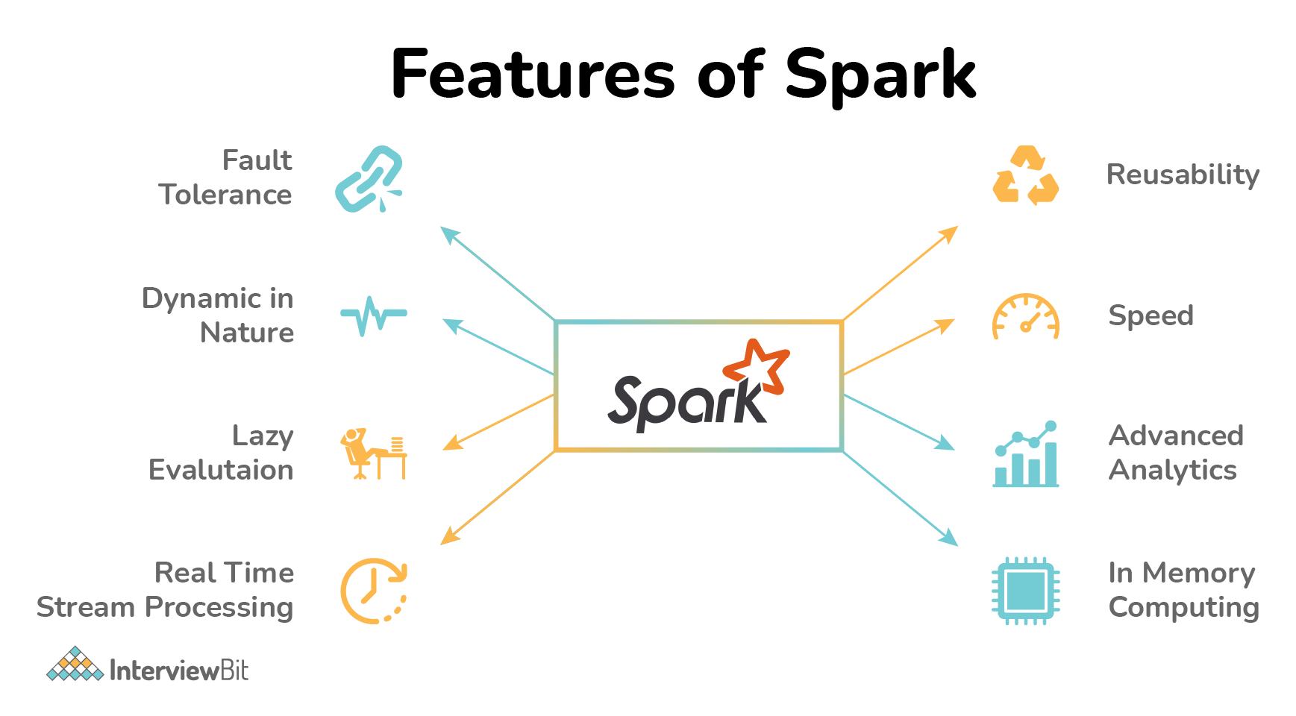

Slide 3
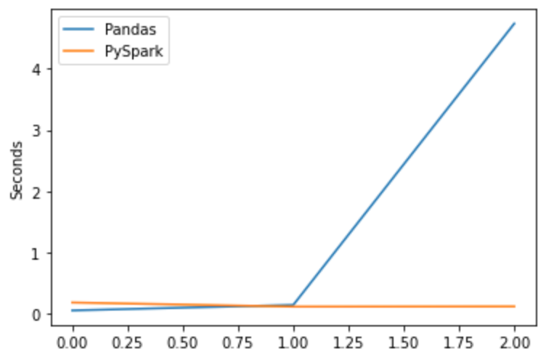
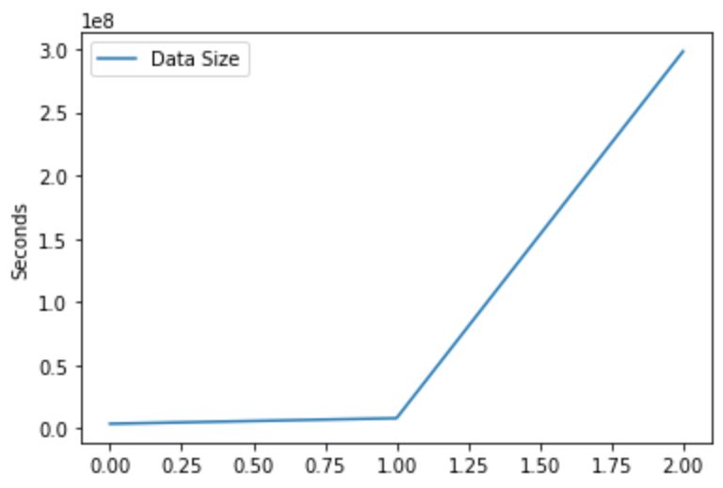
Pandas vs PySpark
Reading time in different datasets.

Slide 4
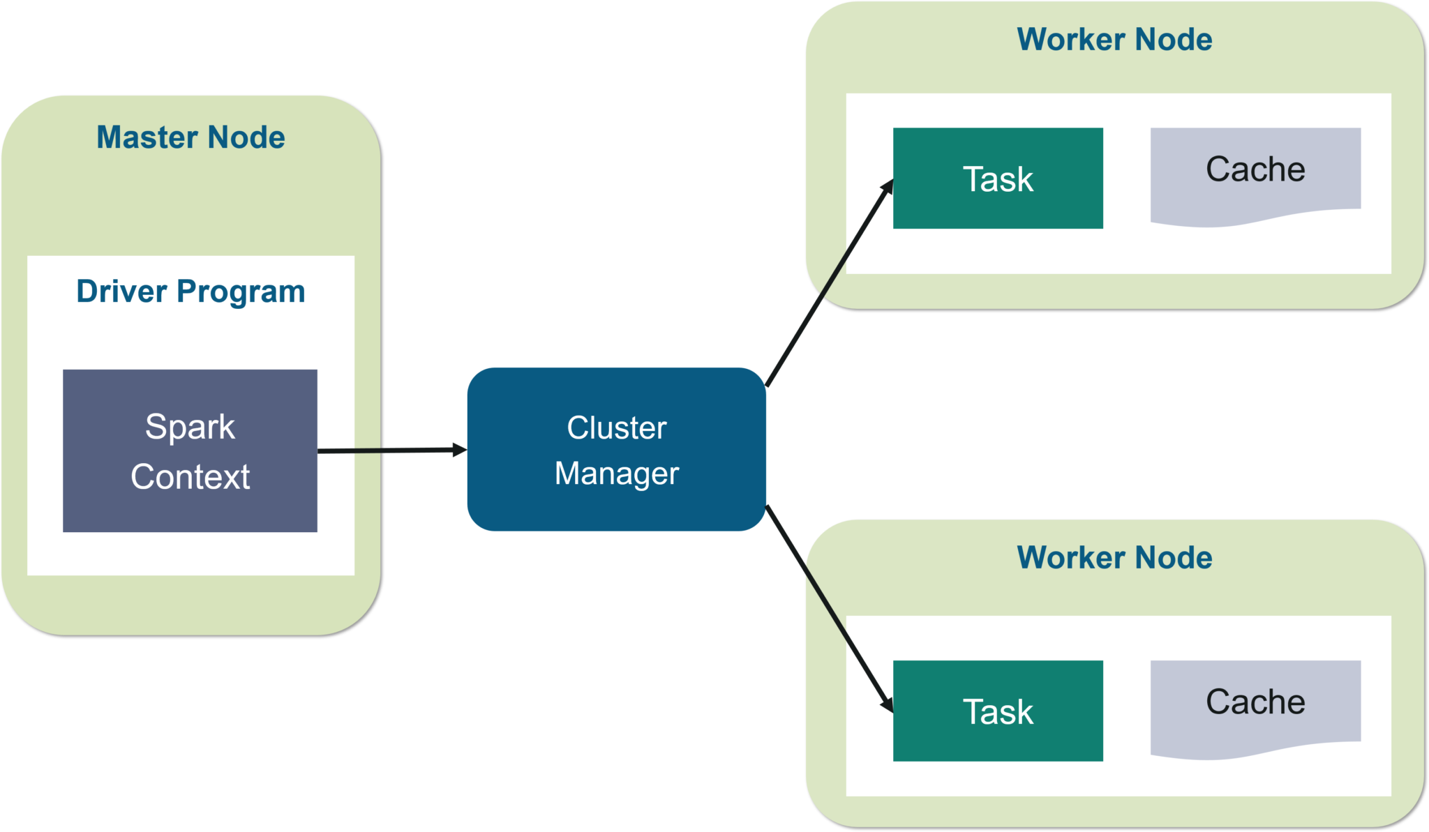
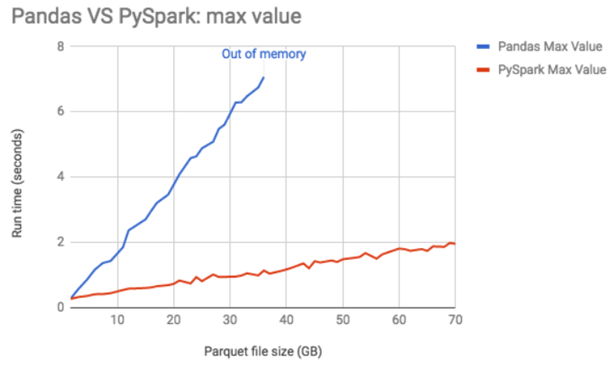
Pandas vs PySpark
PySpark which is a python version of spark, it is creates all of the nodes need to process data.
It uses APIs to create Java jobs to execute spark commands.
Pandas is a python library that enables users to better analyze their data.

Slide 5
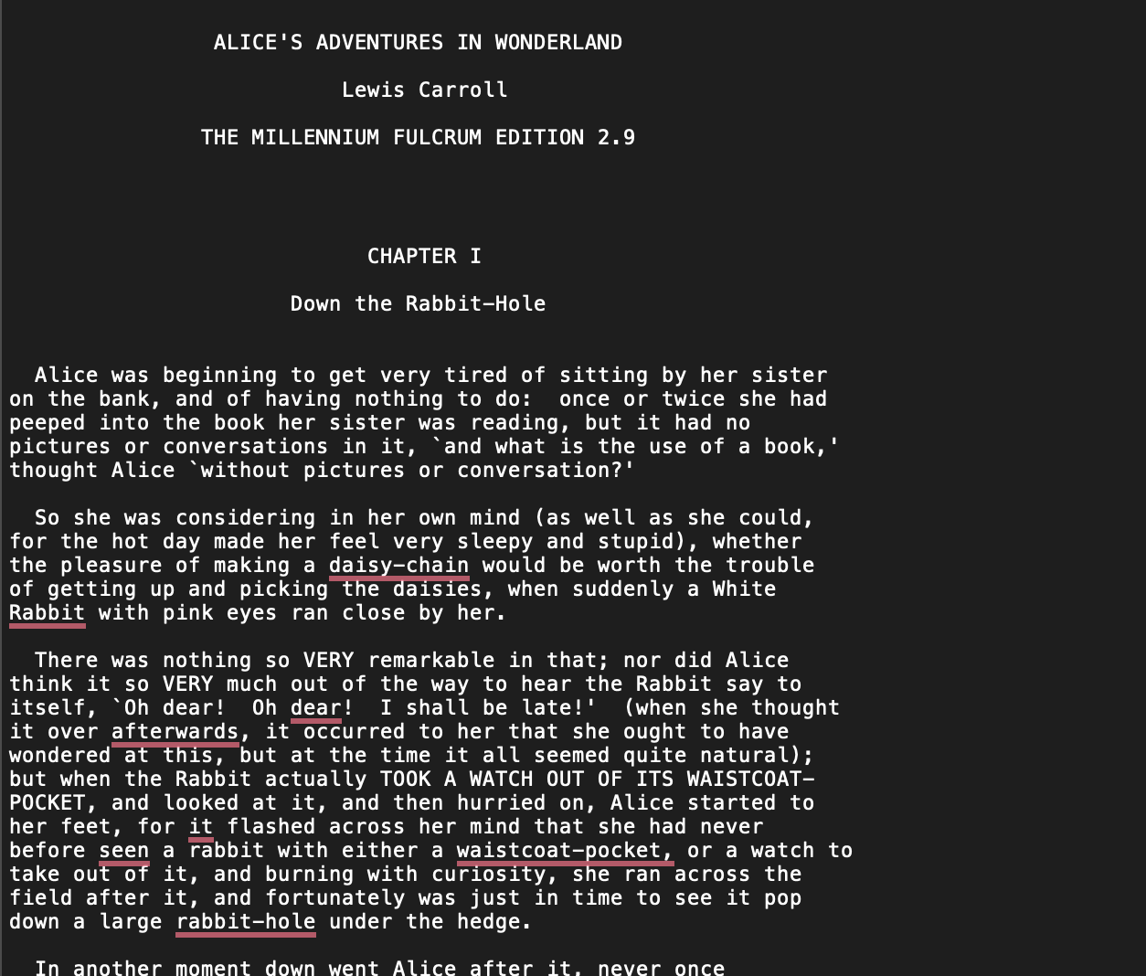
Java Spark Project
Count the number of words present in a file
Parallelizing is needed for large files to ensure you get max performance

Slide 6
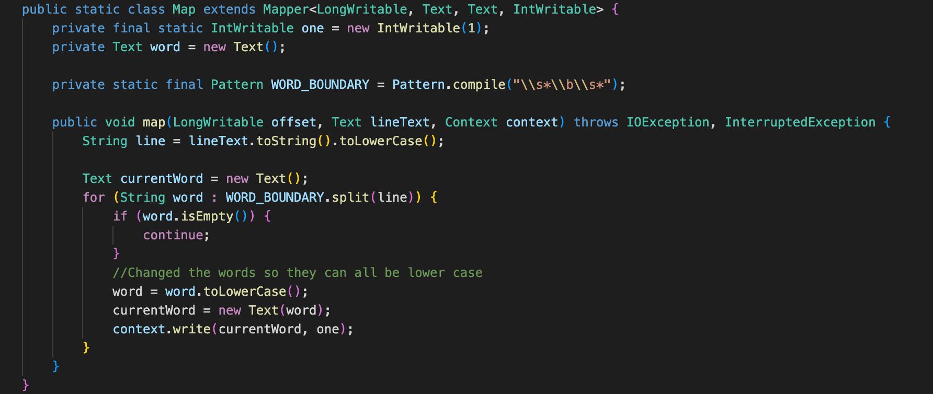
Extract the words

Slide 7
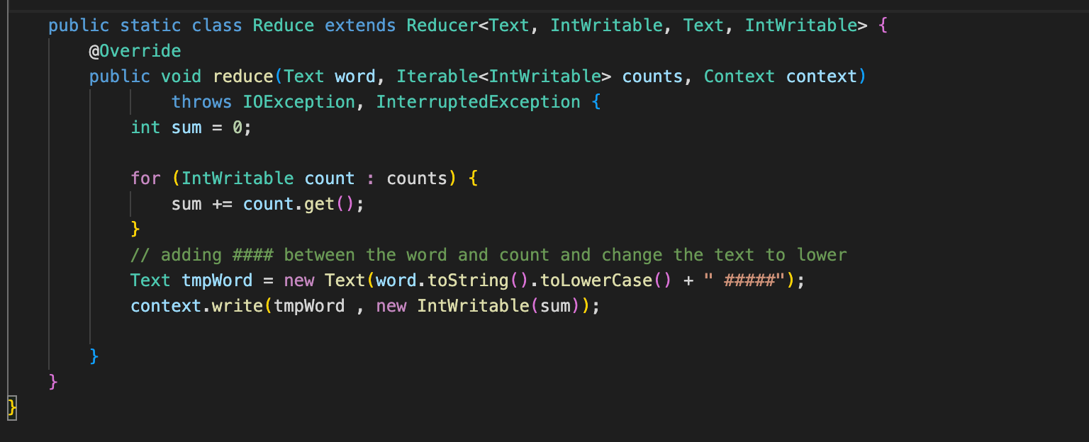
Get a word count and output them

Slide 8
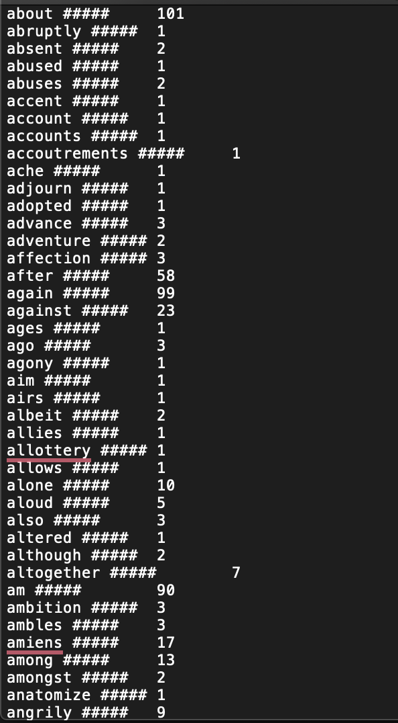
Output

